Slide 1
University Strategy, Strategic Delivery Plans and KPIs
September 2021

Slide 2
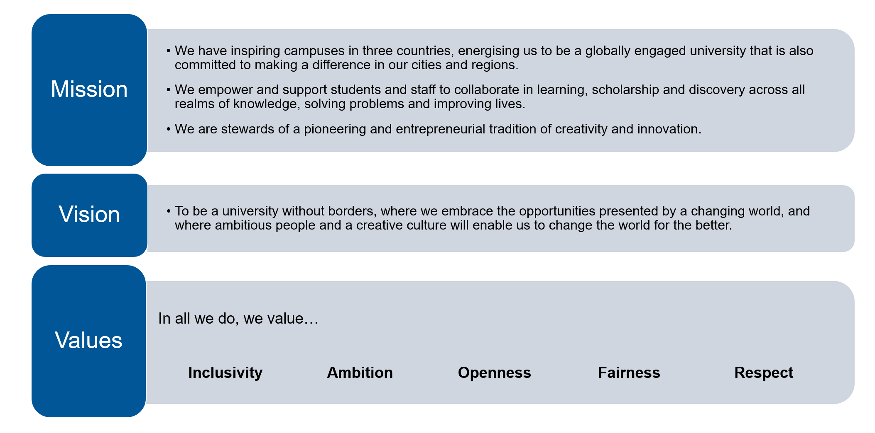
University Strategy December 2019

Slide 3
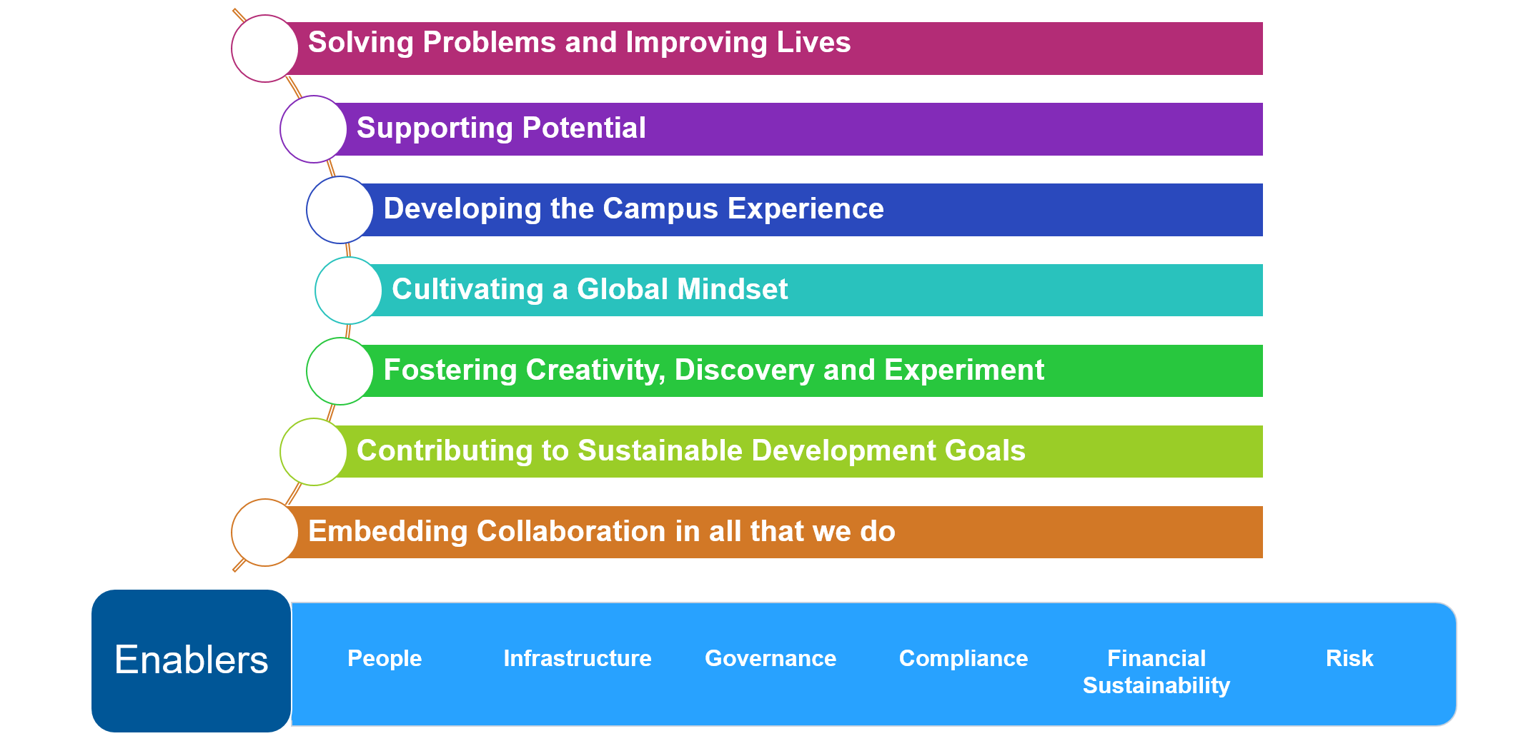
University Strategy December 2019

Slide 4
Strategy & measuring performance
Individual Objectives
Faculty, Professional Service Department & Campus Plans, including KPIs & targets.
Thematic Strategic Delivery Plans (SDPs), with success measures & KPIs
University Strategy, Performance Framework & KPIs
The University Strategy is our foundation, at the heart of all other planning processes.
Each level of planning builds in detail, from the University Strategy, through the SDPs to Business Planning and then links to individual objectives.
The KPIs in the University Performance Framework are linked to the SDPs and cascaded to Business Plans, with appropriate targets agreed at this level.
SDPs will also include a set of success measures & targets.

Slide 5
Thematic Strategic Planning Areas
Strategic Delivery Plans
Education & Student Experience
Research & Knowledge Exchange
Our thematic planning lies between the University strategy and the Business Planning process.
Each plan sets out the priorities for the thematic area and is supported by detailed action planning.
As an a academic led process, our Education & Student Experience and Research & Knowledge Exchange plans provide the main focus for our business planning. Civic & Global Engagement detail where we undertake our academic mission and our functional / influencing plans provide the infrastructure and approach.
Civic & Global Engagement
Functional Delivery & Influencing Plans
Digital
People
Estates
Environmental Sustainability
EDI
Size & Shape
Medium Term Financial Plan

Slide 6
SDP Priorities
Education & Student Experience
Research & Knowledge Exchange
Ensuring ESE is inclusive, agile, responsive & built on feedback from staff & students and good practice
An empowering virtual & physical estate with improved infrastructure, welfare & empowerment
Co create our curricular to embed the University values
Student experience & wellbeing at the heart of everything we do
Diversifying student intake – widening participation, international students, apprenticeships & life long learning
Develop our research strategy for beyond 2022
Foster a culture of performance & define our research ambition
Develop our research environment to be excellent, inclusive & sustainable
Invest in enabling platforms & research infrastructure
Develop our international & multi disciplinary collaboration

Slide 7
SDP priorities
Knowledge Exchange
We will:
develop our culture and capacity to deliver knowledge exchange​
maximise the impact of our innovation and enterprise​
support prosperity in our communities​
enhance how we engage with partners​
deliver meaningful public and policy engagement​

Slide 8
SDP Priorities
Civic
Global Engagement
Universities for Nottingham
Digital Nottingham
Supporting the East Midlands Development Corporation & other regional levelling up opportunities
Student Projects for Nottingham
Supporting local education opportunity through our widening participation programmes & partnerships with local schools
Support local place marketing, business environment & cultural life
Provide an international experience for everyone
Deepen our international research and teaching partnerships
Develop our global curriculum
International mobility
Develop our global campus culture

Slide 9
Potential measurements – for further consultation
Strategic Planning Area | Key Performance Indicator
Education & Student Experience | NSS (mean overall score across questions)
Education & Student Experience | Graduate prospects
Education & Student Experience | Access & Participation Plan targets
Research | Proportion of publications in top 10% most cited, field weighted
Research | Research grant income
Knowledge Exchange | HEBCIS
Environmental Sustainability | Carbon Emissions
Student Recruitment | Percentage student recruitment targets met
Financial Sustainability | Achievement of the Medium-Term Financial Plan
Equality, Diversity & Inclusion | Staff ratios for gender, ethnicity and disability
Notes:
Principle 1: Values Indicators which support our values and are consistent with our commitment to responsible use of metrics.
Principle 2: Clarity Indicators should be clearly defined and understood. Simpler indicators should be preferred to those which are complex to define, derive or explain.
Principle 3: Availability Based on reliable data available without excessive cost.
Principle 4 Performance-oriented We understand and want to see the behaviours that targeting the indicator will lead to.
Principle 5: Cascadable Capable of being reported and targeted at different levels within the University operating model.
Principle 6: Independent Performance relies on UoN actions, not the actions of comparators or competitors.
Principle 7: Benchmarking Indicators which allow reliable comparison with others. Principle 8: Longevity Indicators which enable us to monitor and target performance over time.

Slide 10
Business Planning Round 2021 2022 - planning for 2022/23 – 2024/25
UEB Launch
Faculty Planning
October – February
Professional Service Planning
February – March
Budgeting
April – May
Review
June
Planning within a framework of:
External insights
UoN strategy & priorities
Analysis of previous performance & new University KPIs
Budgets & the Medium Term Financial Plan (MTFP)
University level risks
Staff establishment
Outputs:
Faculty & Professional Service Department Plans
University Business Plan
Updated MTFP & Budgets

Slide 11

Thank you!

